Slide 1
BI Analysis Week 6
Shawna Tuli (Shawna.tuli@avanade.com)

Slide 2
Agenda
Design

Slide 3
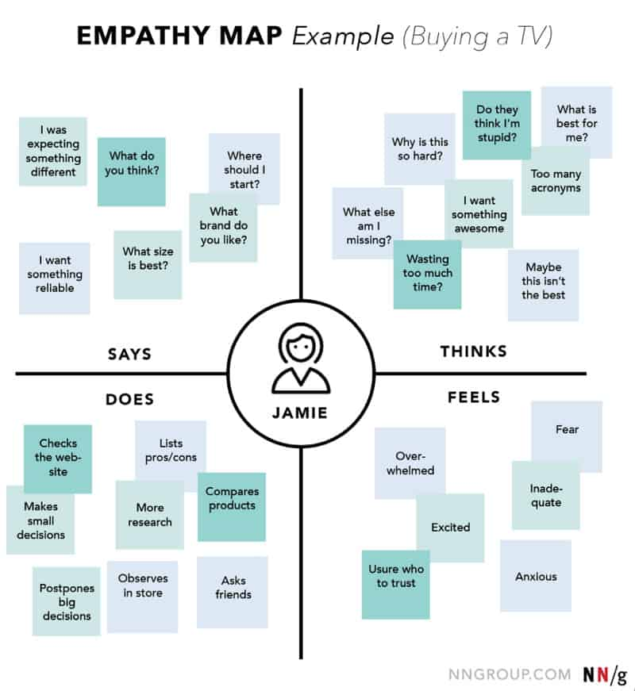
Design

Slide 4
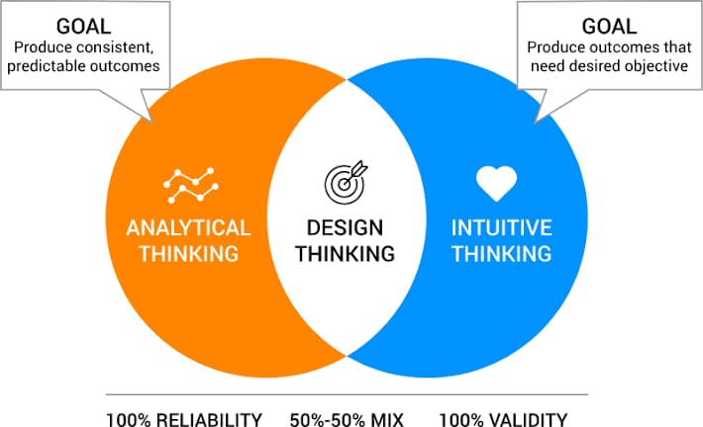

Slide 5
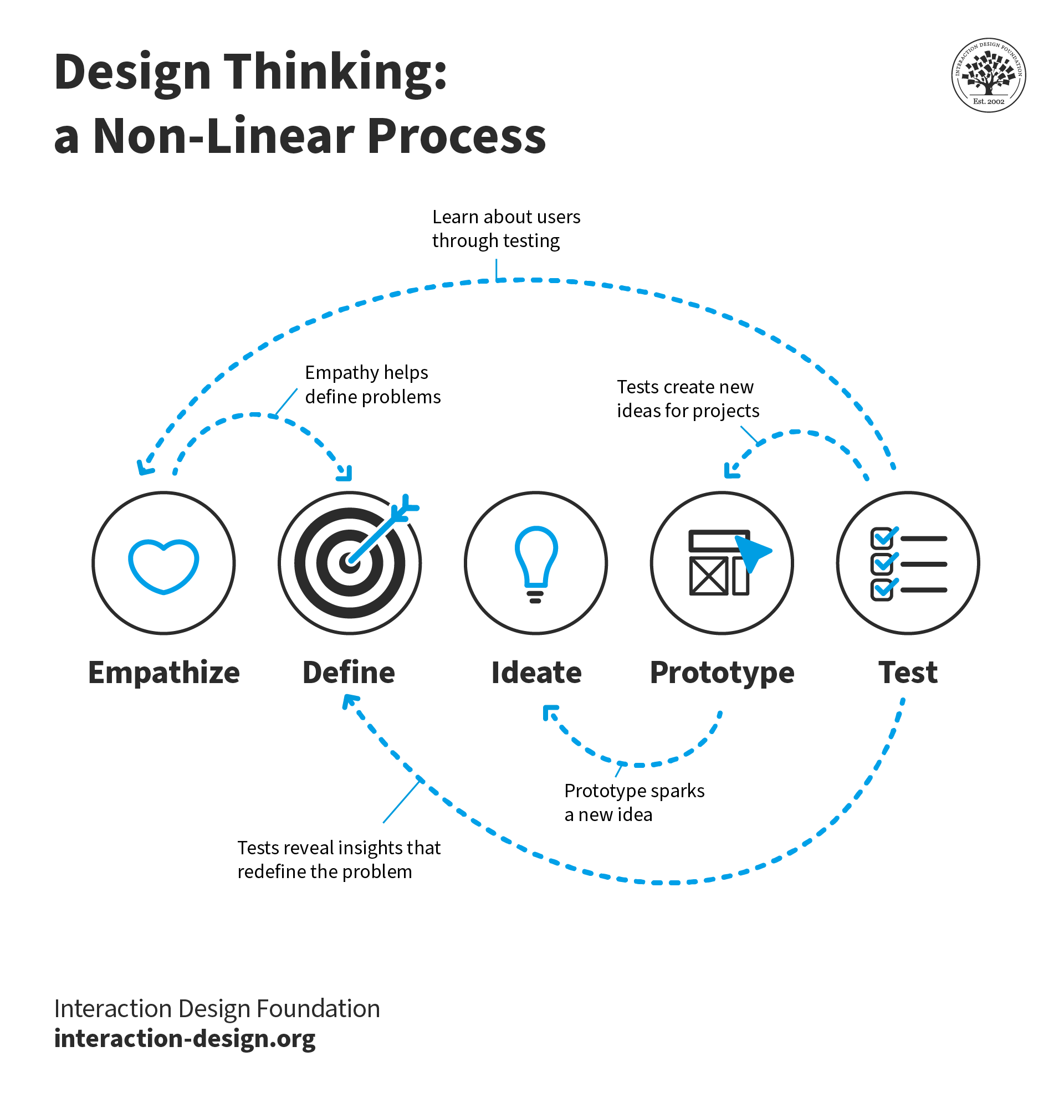

Slide 6
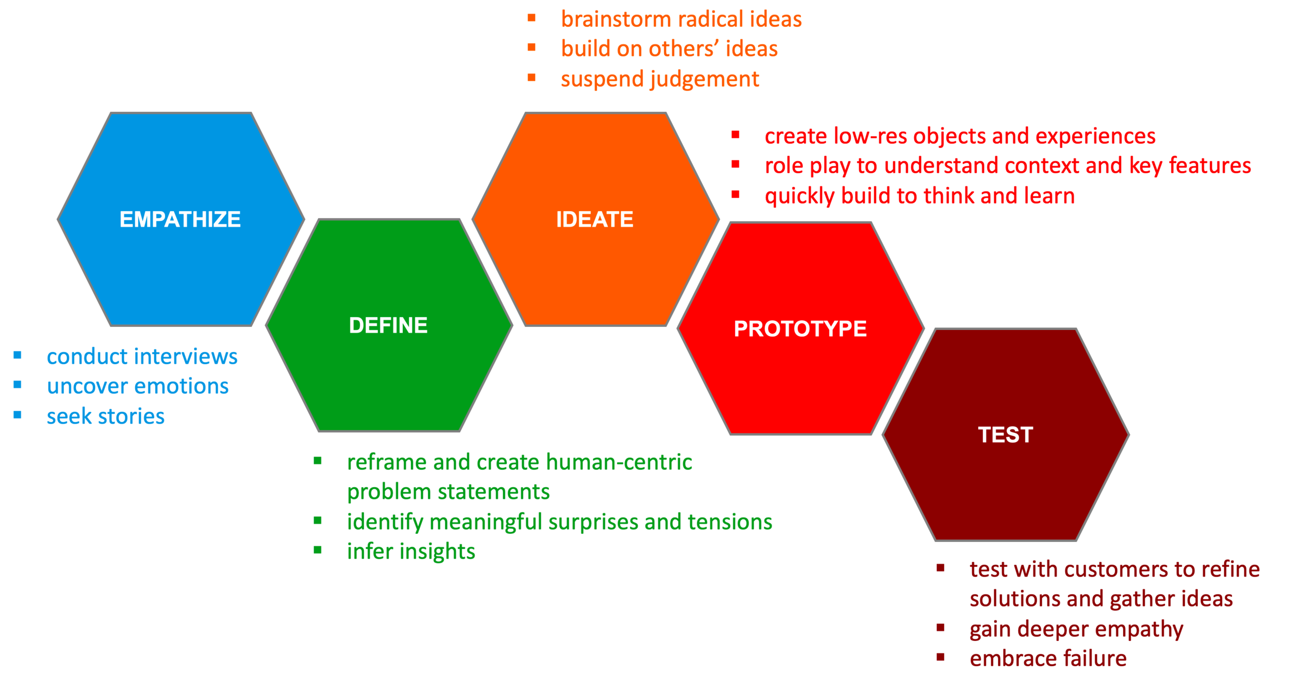

Slide 7
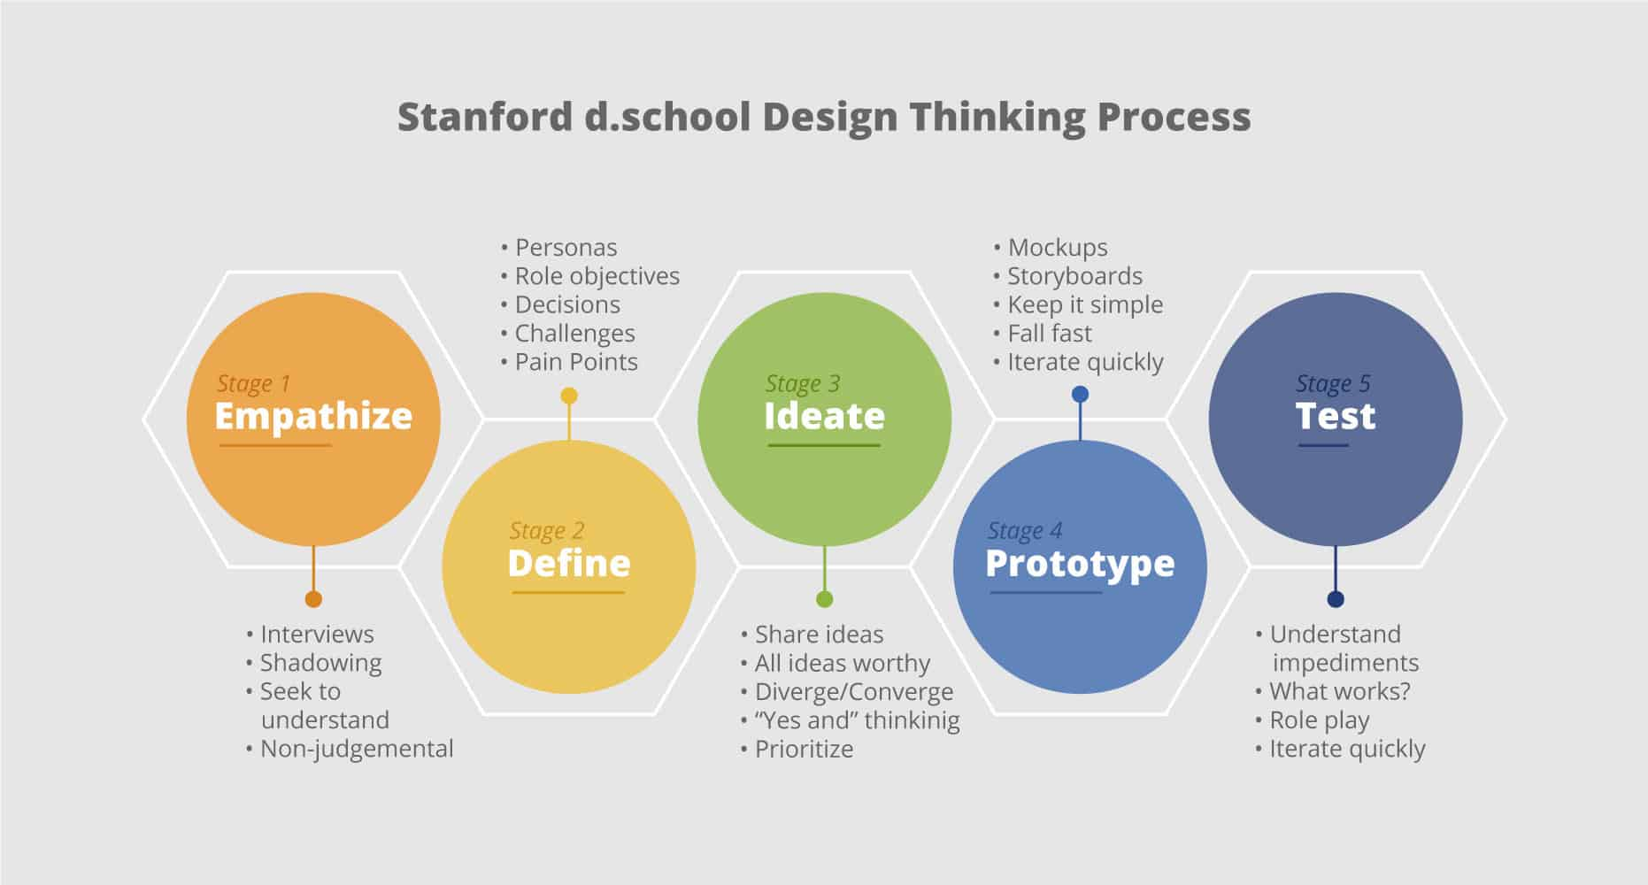

Slide 8
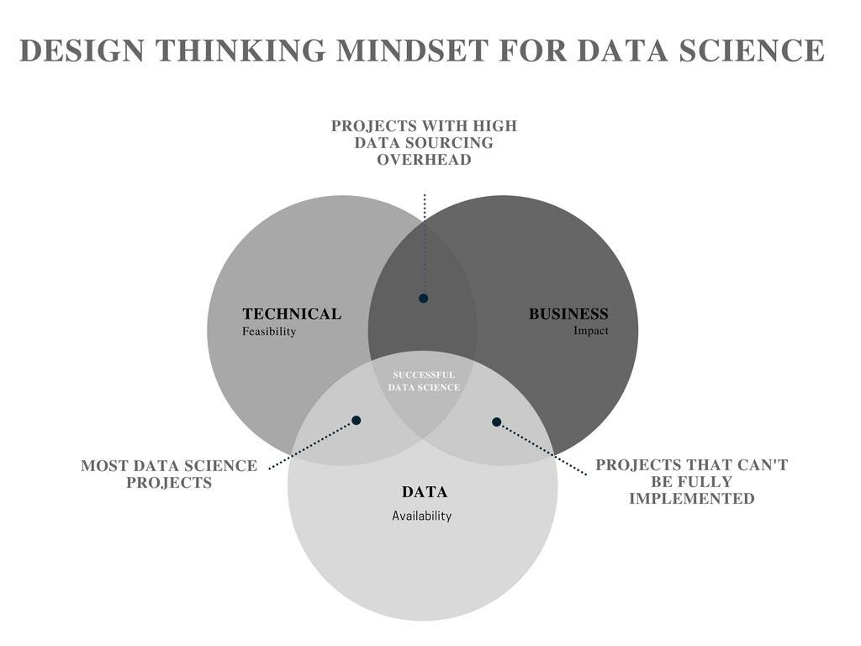

Slide 9
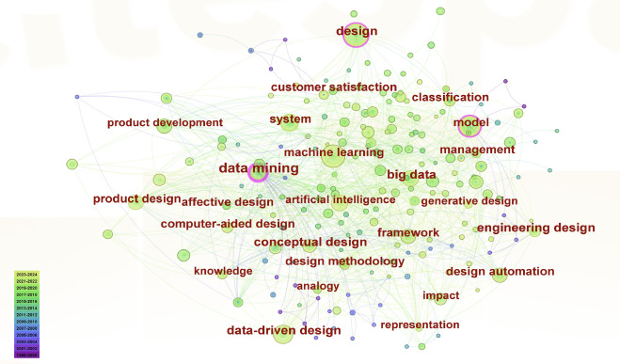

Slide 10
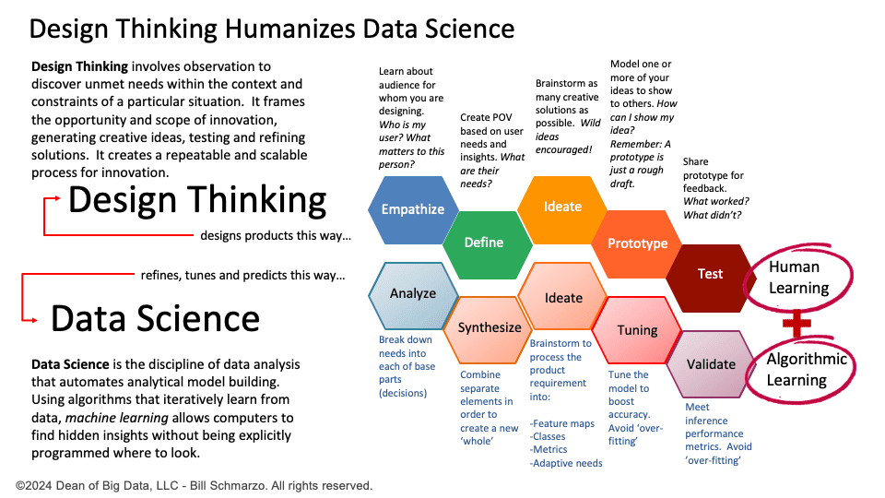

Slide 11
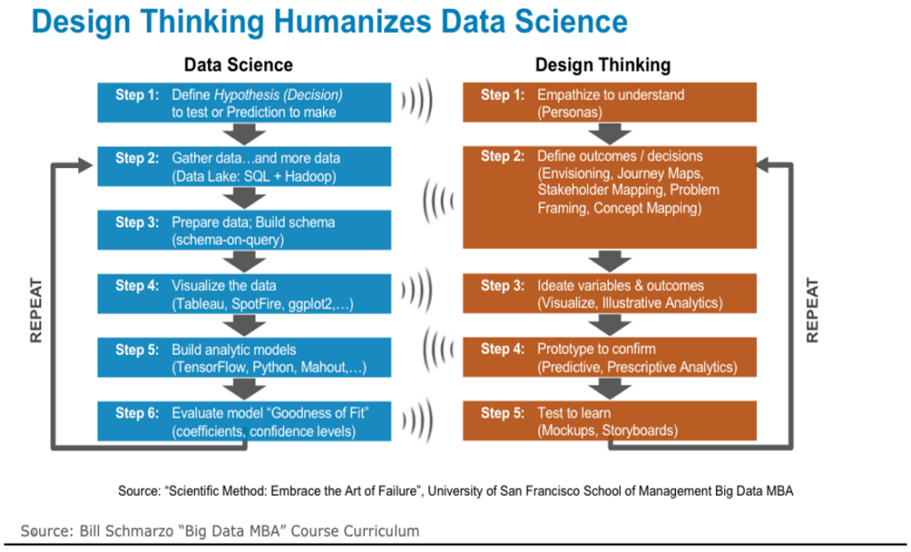

Slide 12
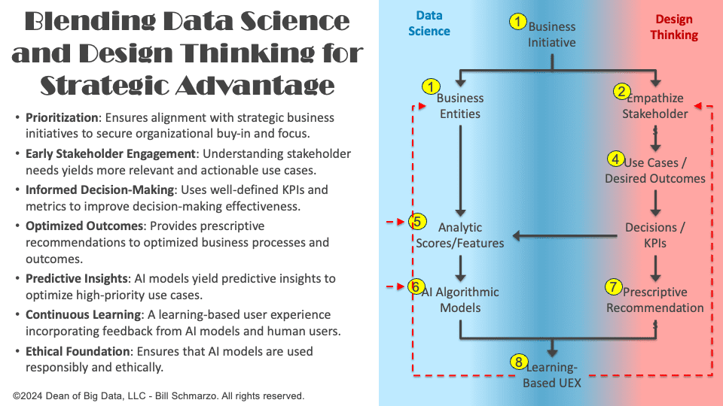

Slide 13
Timeline

Slide 14
Program
Kick-Off
Students will meet their teams and begin planning their project.
4 Workshops
Students will attend guided workshops covering key tools used in data science projects.
Help Sessions
Data@UCI will provide mini help sessions following the end each workshop.
Final Presentations
Groups will have the opportunity to present their projects and win prizes.

Slide 15
Week | Timeline
Week 1 (1/6-1/12) | Regular Event: Info Session for Mentees
Week 2 (1/13 - 1/19) | Regular Event : Project Kick-Off
Week 3 (1/20 - 1/26) | Thursday - Workshop 1: Tour of Notebooks/Environments/IDEs + Help Session
Week 4 (1/27-2/2) | Thursday - Workshop 2: Data Exploration (Pandas & Feature Selection) + Help Session
Week 5 (2/3 - 2/9) | Thursday - Workshop 3: Machine Learning (Scikit-Learn & Model Evaluation) + Help Session
Week 6 (2/10 - 2/16) | Thursday - Collaboration with Design@UCI (tentative + midterms)
Week 7 (2/17 - 2/21) | Thursday - Workshop 4: Data Visualization (Power BI or similar) + Help Session
Week 8 (2/24 - 3/1) | Thursday - Final Winter Project Help Session
Week 9 (3/3 - 3/9) | Thursday - Final Presentations

Slide 16
Deliverables

Slide 17
Week | Deliverable
Week 1 (1/6-1/12) | Commitment
Week 2 (1/13 - 1/19) | Meeting Series
Week 3 (1/20 - 1/26) | Jupyter Notebooks
Week 4 (1/27-2/2) | Exploratory Data Analyses
Week 5 (2/3 - 2/9) | Machine Learning
Week 6 (2/10 - 2/16) | Design
Week 7 (2/17 - 2/21) | Data Visualization
Week 8 (2/24 - 3/1) | Presentation
Week 9 (3/3 - 3/9) | Final Presentation

Slide 18
Thank you!

